Slide 1
Traffic Sign Classification
Phase - 1 Presentation

Slide 2
About the team
Guide
Mr. Ramesha Shettigar
Assistant Professor Grade II
Members
Keertan Kini B - 4NM17CS085
Kishan - 4NM17CS090
Manjunatha Patkar - 4NM17CS100
Manukashyap U V - 4NM17CS101

Slide 3
Problem Statement
Creation of an automatic, fast and lightweight system that is capable of real time detection, classification and interpretation of the traffic signs

Slide 4
Objectives
Train a deep learning model on an industry standard database of traffic signs.
Refine the model to detect traffic signs with large intra-category appearance variation.
Provide real time detection, classification and interpretation of the traffic signs

Slide 5
Literature Survey

Slide 6
Paper Name | Abstract | Methods | Conclusion and Future work
Towards Reliable Traffic Sign Recognition -Benjamin H ̈oferlin Intelligent Systems Group Universit ̈ at Stuttgart Stuttgart, Germany benjamin.höferlin@vis.uni-stuttgart.de -Klaus Zimmermann European Technology Center (EuTEC) Sony Deutschland GmbH Stuttgart, Germany klaus.zimmermann@sony.de | ● System architecture for reliable detection of circular traffic signs. ● First research into computer aided traffic sign detection in the 80s. ● Usage of color segmentation, color thresholding and Bayesian classification of color in old research. ● Hough transform and its derivatives. | ● Detection ○ Two fold detection stage ○ Shape based detection ○ Content based detection ● Refinement ○ Contracting Curve Density Algorithm ● Classification ○ Two Multi-Layered Perceptrons | ● Conclusion ○ 30 minute long test yielded 96.4% correct detections. ● Future Work ○ Detection of non circular signs ○ Better methods for classification

Slide 7
Paper Name | Abstract | Methods | Conclusion and Future work
Detection And Recognition of Indian Traffic Signs - Pritika Priya Dhara Modha, Mansi Agrawal Department Of Information Technology,Bharati Vidyapeeth College Of Engineering For Women, Pune-43 | ● An automatic system which would detect, recognize and interpret the meaning of the traffic signs for the driver. ● Use of several image processing techniques to enhance the efficiency and speed of the system. ● Disburden the drivers and reduce road accidents for a better and safe driving, thus implementing the concept of intelligent vehicle. | ● Detection ○ Image blurring algorithm ○ Color filtering Blob detection ● Classification ○ Based on shapes: circle, rectangle and triangle. ● Recognition ○ Use of pattern matching algorithms to compare extracted ROI with standard templates. ○ If pattern is found, sound notification is given to the driver otherwise the image is discarded. | ● Conclusion ○ Describes the system that is strictly used to differentiate Indian Traffic Signs that is subdivided in three classes according to the shapes. ● Future Work ○ Improve the robustness of the system. ○ Make the system work for highly tilted signs.

Slide 8
Paper Name | Abstract | Methods | Future work
Deep Learning for Large-Scale Traffic-Sign Detection and Recognition -Domen Tabernik and Danijel Skoˇcaj Faculty Computer and Information Science, University of Ljubljana Veˇcna pot 113,1000 Ljubljana {domen.tabernik,danijel.skocaj}@fri.uni-lj. si | ● Use of Mask R-CNN for Traffic sign detection and recognition. ● Using deep learning method for detection of traffic signs with large intra-category appearance variation. ● This approach is used for detection of 200 traffic-sign categories. | ● Detection and Recognition using Mask R-CNN ○ Online hard-example mining (OEHM) ○ Distribution of selected training sample ○ Sample weighting ○ Adjusting region pass-through during detection ● Data augmentation technique ○ This technique is used to generate several instances of traffic-signs and hence provide diverse data for the deep learning model. | ● Conclusion ○ Average precision of 97.5% achieved in correct detections with an error rate of just 2%-3%. ● Future Work ○ Improving the system to achieve ideal performance.

Slide 9
Paper Name | Abstract | Methods | Conclusion and Future work
Traffic Sign Classification Using Deep Inception Based Convolutional Networks -Mrinal Haloi IIT Guwahati mrinal.haloi11@gmail.com | ● Use of spatial transformer layers and a modified version of inception module specifically designed for capturing local and global features together. ● Classify precisely intraclass samples even under deformations. ● This approach addresses the concern of exploding parameters and augmentations. | ● Transformation invariant ○ Localisation network ○ Grid generator ○ Sampling unit ● Proposed Pipeline ○ A modified version of GoogLeNet Inception module is used for classification task. ● GTSRB data set is used for training and testing. | ● Conclusion ○ Achieves the state-of-the-art performance of 99.81% on GTSRB dataset. ● Future Work ○ Improving the system to achieve ideal performance.

Slide 10
Paper Name | Abstract | Methods | Conclusion and Future work
Indian Traffic Sign Detection and Classification Using Neural Networks -Arun Nandewal CSE Department arunnandewal@gmail.com Abhishek Tripathi IT Department abhishek.tripathi2421@gmail.com Satyam Chandrra EEE Department satyam9871@gmail.com NITK Surathkal | ● This paper presents an automatic Indian Road Traffic Sign Detection and Classification system based on Multiple Neural Networks. ● Validated on a standard data set of Indian Traffic Signs. ● Proposed methodology works with real time images invariant to rotation, illumination and with partially distorted and occluded images. | The proposed system has 4 stages: ○ Image procurement and preprocessing ○ Color segmentation ○ Blob Detection using Binarization and Otsu Thresholding. ○ Classification using Multiple Neural Networks to decide the type of sign. | ● Conclusion ○ when the NN is trained over a standard database, the recognition of ROI has high accuracy. ● Future Work ○ Real time implementation requires more robust system which has reduced proceeding time.

Slide 11
Phase - 1 Progress

Slide 12
About the data set
GTSRB - German Traffic Sign Recognition Benchmark
German Traffic Sign Recognition Dataset (GTSRB) is an image classification dataset. The images are photos of traffic signs. This benchmark has the following properties:
Single-image, multi-class classification problem
More than 40 classes
More than 50,000 images in total
Large, lifelike database

Slide 13
Convolution Neural Network
CNN is a machine learning algorithm that can take an input image, assign importance to various aspects or objects in the image, and be able to differentiate one from another.
CNN works by extracting the features from the images. Any CNN consists of the following:
The input layer which is a grayscale image.
The output layer which is a binary or multi-class labels.
Hidden Layers consisting of convolution layers, ReLU (rectified linaer unit) layers, the pooling layer, and a fully connected Neural Network.

Slide 14
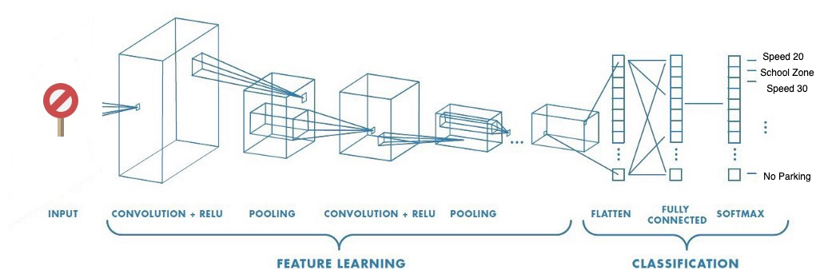
CNN Model for TSC

Slide 15
Libraries used
Numpy
Matplotlib
Tensorflow
Keras
OpenCV-Python
SKLearn
Pandas
Pickle

Slide 16
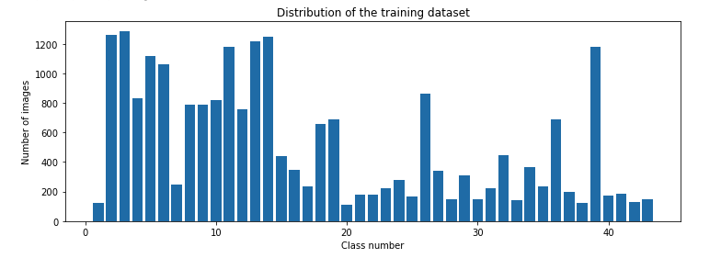
Data set analysis
34799 Images distributed over 42 Classes

Slide 17


Image Classification and Augmentation
Classification
Augmentation

Slide 18
Future Work
Train the model.
Test the model.
Validate the model.
Save the model.
Create interface to interact with the model.
Add real time interaction with the model using webcam.

Slide 19
Thank you

